Slide 1
Micro Service

Slide 2
Course Goals
Understanding of MicroService
What is Monolithic architecture
How Microservice are different from Monolithic
Understanding the Pros and Cons of Microservices
Understanding the Cloud concept
Developing MicroService Applications

Slide 3
What is Service ?
What is Monolithic Architecture
Introduction to Microservice
Emergence of Microservice
Benefits of Microservice Architecture
Diff between Microservice and Monolithic
Challenges in Microservices

Slide 4
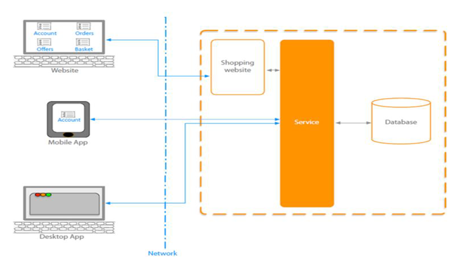
What is Service?

Slide 5
What is Service?
Service is a piece of SW which provides the functionalities to the other pieces of SW . It could be
CRUD app service
Validation service etc.
Service should be implemented in a SOA/REST where the functionality should be reusable and can communicate to Client application and other services.

Slide 6
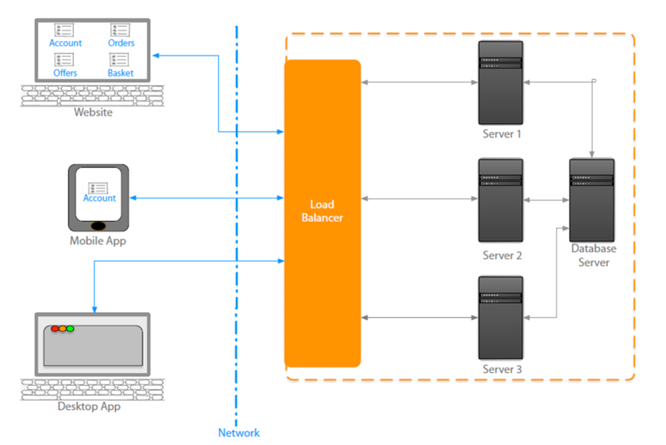
What is Service-Big Picture
In a distributed application, SOA implemented service can be distributed among multiple server with proper scalability and can be reuse by any of application
Notes:
In a distributed application , SOA implemented Service can be distributed among multipleserver with proper scalability and
Can be reuse by any type of application .
When the traffic come for service , then the Load balancer can redirect the traffic to the different server instance where the service is running
We can have multiple instance of the service will be running on Different web server.
The few important characteristics of services are
▪It is stateless : -Request come for a single service instance doesn’t require to remember the previous request.
▪It provides a common interface to all type of application where the functionality is declared and encapsulate the implementation from client
When the demand increases , we can increase the number of instances of the service

Slide 7
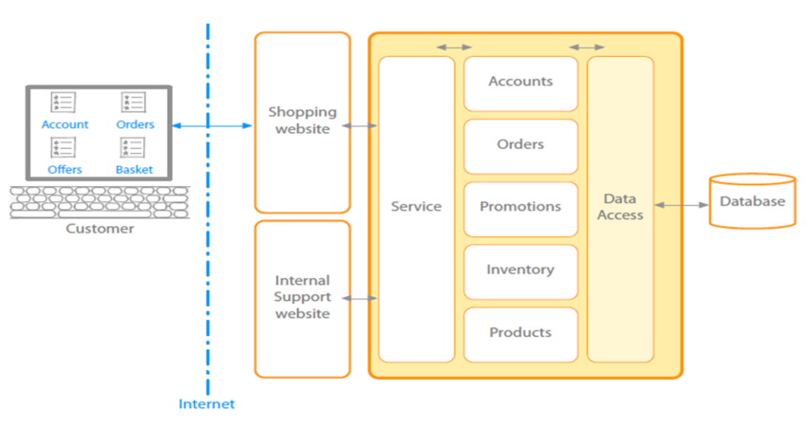
What is Monolithic Architecture
The monolithic architecture is an architectural style which structures the complete application into one executable component.

Slide 8
What is Monolithic Architecture
It is good for small Application where the below three utility can be easily maintained.
Maintainability
Testability
Deployibility
Monolithic software is designed
to be self-contained; components of the
Program which are interconnected and
interdependent rather than loosely coupled

Slide 9
Challenges –Monolithic Architecture
A typical enterprise application
No restriction on size
Large codebase
Longer development times
Inaccessible features
Fixed technology stack
High level of coupling between modules and services
Failure could effect whole system
Single service on server
Minor change could result in complete rebuild
Notes:
A successful application always try to grow where the Monolithic architecture faced the problem
Monolithic Architecture is
•A typical enterpriseapplication
•No restriction on Size
•Large codebase
•Longer development times
•Inaccessible features
•Fixed technology stack
•High level of coupling between Modules and services
•Failure could effect whole system
•Single service on server
•Minor change could result in complete rebuild
Challenges started where the application became
bigger in size .
Agile development and deployment became very
difficult or may be impossible.
In a tightly-coupled architecture, each component
and its associated components must be present in
order for code to be executed or compiled.
if any program component must be updated, the whole application has to be rewritten

Slide 10
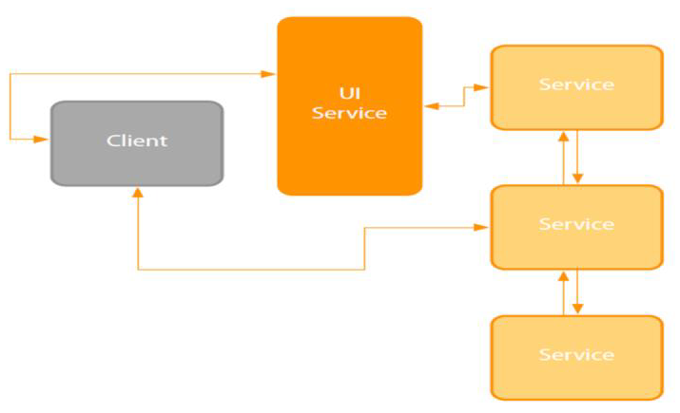
Intro. To MicroService Architecture
This is a kind of architectural style which structures an application as a set of loosely coupled, services organized around the business capabilities.
It is a improved version of SOA/ROA.
Notes:
➢SOA done well
•Knowing how to size a service
•Traditional SOA resulted in monolithic services
➢Micro sized services provide
•Efficiently scalable applications
•Flexible applications
•High performance applications
➢Application(s) powered by multiple services
➢Small service with a single focus
➢Lightweight communication mechanism
•Both client to service and service to service
➢Technology agnostic API
➢Independent data storage
➢Independently changeable
➢Independently deployable
➢Distributed transactions
➢Centralized tooling for management

Slide 11
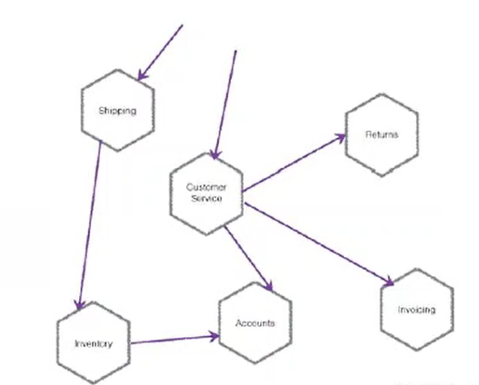
What is Micrservice?
Small independently deployable services that work together, modelled around a business domain.

Slide 12
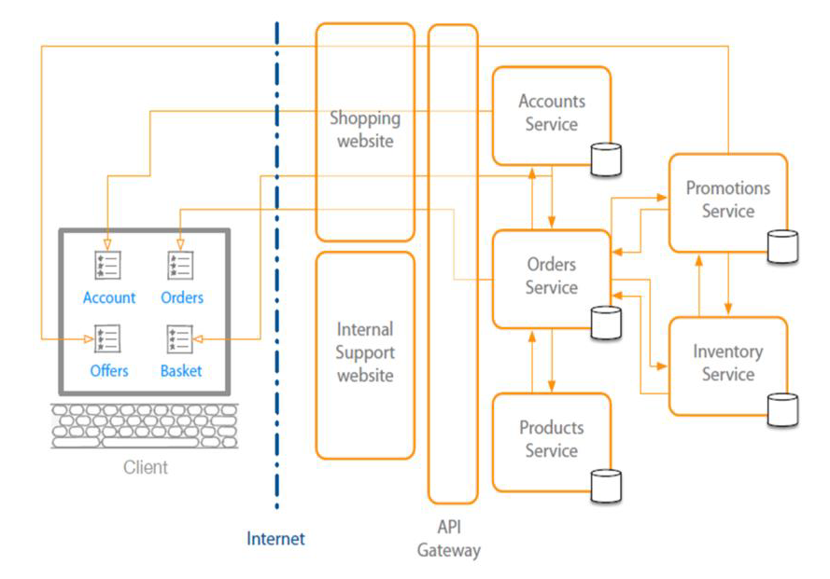
Micro Service Big Picture

Slide 13
Micro Service Big Picture
Service is a independently Deployable component and certainly implementing some business rules.
Each service should have its own database which is very important from loos coupling point of view.
Micro services are as per the Business requirement .
One can design small Micro business services independently .
All Micro services are loosely coupled So changes in one will not effect the other Service .
In Implementation view we can have multiple service component .war files

Slide 14
Emergence of MicroServices
Need to respond to change quickly
Need for reliability
Business domain-driven design
Automated test tools
Release and deployment tools

Slide 15
Emergence of MicroServices
On demand hosting technology
On line cloud services
Need to embrace new technology
Asynchronous communication technology
Simpler server side and client side technology

Slide 16
Benefits of Micro Service Architecture
It enables the continues delivery and deployment of large, complex applications.
Better testability
Better deployibility
It enables you to organize the development effort around multiple teams.
Each team ( of 2 to 5 members) owns and is responsible for one or more single service.
Each team can develop, deploy and scale their services independently of all of the other teams.

Slide 17
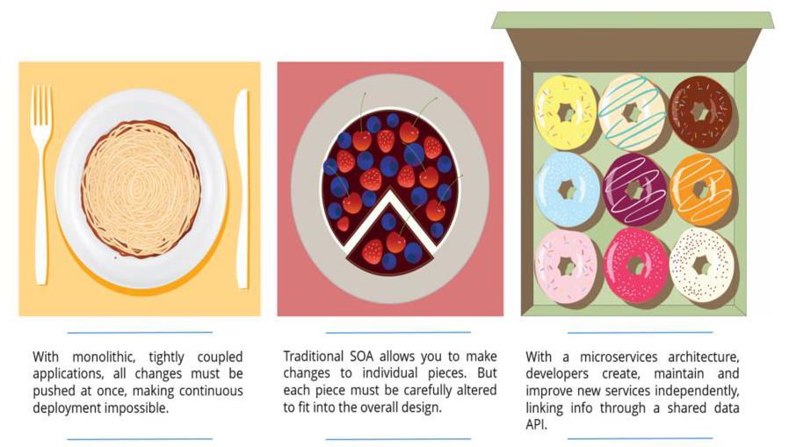
Benefits of Micro Service Architecture
Notes:
Shorter development times
•Reliable and faster deployment
•Enables frequent updates
•Decouple the changeable parts
•Security
•Increased uptime
•Fast issue resolution
•Highly scalable and better performance
•Better ownership and knowledge
Right technology
•Enables distributed teams

Slide 18
Benefits of Micro Service Architecture
Each Micro Service is relatively small.
For Developer, it is easy to understand
Because of small size, the IDE is faster making developers more productive.
The application starts faster which makes the developers speeds up the deployment
It allows the easy and flexible way to integrate automatic deployment with continuous integration tools(Jenkin, Hudson etc…)
It improved fault isolation
Eliminates any long-term commitment to a technology stack.
Notes:
Page 01-14
Instructor Notes:
Enables the continuous delivery and deployment of large, complex applications.
Better testability -services are smaller and faster to test
Better deployability -services can be deployed independently
It enables you to organize the development effort around multiple, auto teams. It enables you to organize the development effort around multiple teams. Each (two pizza) team is owns and is responsible for one or more single service. Each team can develop, deploy and scale their services independently of all of the other teams.
Each microservice is relatively small
Easier for a developer to understand
The IDE is faster making developers more productive
The application starts faster, which makes developers more productive, and speeds up deployments
Improved fault isolation. For example, if there is a memory leak in one service then only that service will be affected. The other services will continue to handle requests. In comparison, one misbehaving component of a monolithic architecture can bring down the entire system.
Eliminates any long-term commitment to a technology stack. When developing a new service you can pick a new technology stack. Similarly, when making major changes to an existing service you can rewrite it using a new technology stack.

Slide 19
Benefits of Micro Service Architecture
It has code for business logic only, no mix up with html, css and other UI components
It can be deployed on commodity hardware or low/medium configuration server.
Easy to integrate with 3rd party service.
Each micro service has it’s own database but it depends upon requirement
One can use common DB ie Oracle, Mysql for all service.

Slide 20
Benefits of Micro Service Architecture
Focus on one thing and do it right
Organizational alignment
Release functionality faster
Enables frequent updates
Decouple the changeable parts
Enable Security concern segregation
Enable resiliency by designing for failure
Increased uptime
Fast issue resolution, Reliable and faster deployment
Independent scaling ,Highly scalable and better performance
Better ownership and knowledge
Right technology , Technology Flexibility
Enables distributed teams
Deployment Flexibility, can be scaled separately

Slide 21
Disadvantages/Challenges
Disadvantages:
Deployment / architecture Complexity
Service Discovery
Challenges:
Lots of technologies
Lots of Patterns
Interdependent Concepts

Slide 22
Micro Services Design principle
High Cohesion
Autonomous
Business Domain Centric
Resilience
Observable
Automation

Slide 23
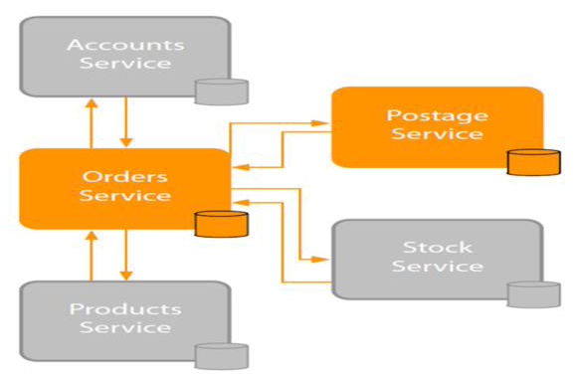
MicroServices Design principle-High Cohesion
It gives you scalability , flexibility and reliability
Notes:
Single focus
Single responsibility
•SOLID principle
•Only change for one reason
•Reason represents
•A business function
•A business domain
•Encapsulation principle
•OOP principle
•Easily rewritable code
Why
•Scalability
•Flexibility
•Reliability

Slide 24
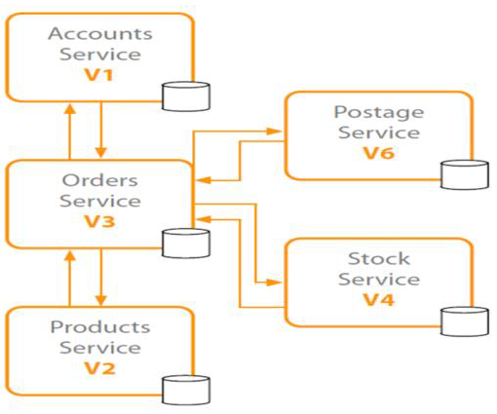
MicroServices Design principle-Autonomous
Loose Coupling, Stateless and concurrent development
Notes:
Loose coupling
•Honor contracts and interfaces
Stateless
•Independently changeable
Independently deployable
•Backwards compatible
Concurrent development

Slide 25
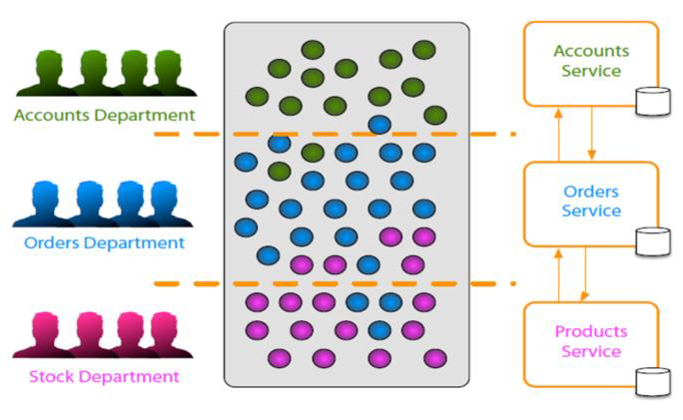
MicroServices Design principle-Autonomous
Service represents business function
Scope of service
Responsible to Business changes
Notes:
Service represents business function
•Accounts Department( Specific SW code for Accountingrelated )
•Postage calculator ( Business functionality)
Scope of service
Bounded context from DDD(Domain DrivenDesign)
Identify boundaries\seams
Shuffle code if required
•Group related code into a service
•Aim for high cohesion
Responsive to business change( Based 0n Business change , microservice also changeaccordingly)

Slide 26
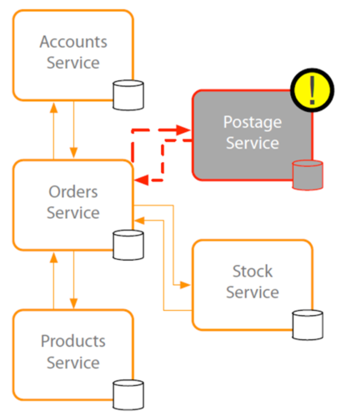
MicroServices Design principle-Autonomous
If one service fails, it didn’t disturb the process of other system
Design for known failure
Degrade functionality on failure detection
Default functionality on failure detection
Notes:
Embrace failure
•Another service
•Specific connection
•Third-party system
Degrade functionality
Default functionality
Multiple instances
•Register on startup
•Deregister on failure
Types of failure
•Exceptions\Errors
•Delays
•Unavailability
Network issues
•Delay
•Unavailability
Validate input
•Service to service
•Client to service

Slide 27
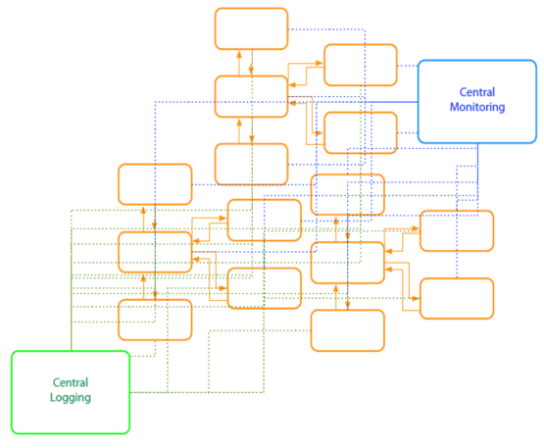
MicroServices Design principle-Observable
Centralized Monitoring
Real time monitoring
Monitor the host
CPU,Memory, Disk usage etc.
Expose Metrics with in the service
Notes:
System Health
•Status
•Logs
•Errors
Centralized monitoring
Centralized logging
Why
•Distributed transactions
•Quick problem solving
•Quick deployment requires feedback
•Data used for capacity planning
•Data used for scaling
•What's actually used
•Monitor business data

Slide 28
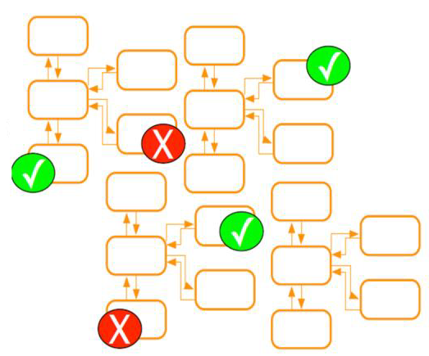
MicroServices Design principle-Automation
It use tools to do testing and provide feedback automatically
CI tools
Work with source control system
Automatic after check in
Unit testing and integration testing required for production code.
Notes:
Tools to reduce testing
•Manual regression testing
•Time taken on testing integration
•Environment setup for testing
Tools to provide quick feedback
•Integration feedback on check in
•Continuous Integration
Tools to provide quick deployment
•Pipeline to deployment
•Deployment ready status
•Automated deployment
•Reliable deployment
•Continuous Deployment
Why
•Distributed system
•Multiple instances of services
•Manual integration testing too time consuming
•Manual deployment time consuming and unreliable

Slide 29
Micro Service Vs Monolithic
Monolithic | MicroServices
Single deployment | Every micro service is a separate deployment. Many more modules with specific functionality and it ensures module dependency
This type of application puts all its functionality into a single process. | This architecture puts each element of it functionality into a separate service.
Single codebase | More than one code base
Interaction between classes are synchronous | More than one code base

Slide 30
Micro Service Vs Monolithic
Monolithic | MicroServices
The whole app has one DB. | Every micro service has its own DB
It scales by replicating the monolithic on multiple servers | It scales by distributing these services and replicating as needed
Any changes in application requires a full redeploy | It is loosely coupled , any changes in one service will not effect another service.
Hard to work with multiple teams | It is easy, as the size of the service is small and independent
If the application is big then hard to manage | It separate deployment, separate monitoring

Slide 31
Micro Service Vs Monolithic
Monolithic | MicroServices
Continuous deployment is difficult | Continuous deployment is easy
Bug in any module (e.g. memory leak) can potentially bring down the entire process. Here all instances of the application are identical, so that bug will impact the availability of the entire application. | Bug in one service can only effect that service. It can’t effect other service.
Monolithic application has a barrier to adopting new technologies | Micro services supports to adopt the new technology

Slide 32
Challenges in Micro services
Challenges
It brings a lot of operation overhead.
Because of distributed deployment, difficult to trace problem
Complicated to manage whole products where number of service increase.
Drawbacks
Developer tools/IDEs are oriented on building monolithic applications and don’t provide explicit support for developing distributed applications
Increased memory consumption. The Microservices architecture replaces N monolithic application instances with NxM services instances. If each service runs in its own (JVM or equivalent), which is usually necessary to isolate the instances, then there is the overhead of M times as many JVM runtimes. Moreover, if each service runs on its own VM (e.g. EC2 instance), as is the case at Netflix, the overhead is even higher.

Slide 33
Micro Service implementation Stack
Spring Boot and Spring Cloud
Microservice with Python
Microservice with PHP
Prometheus Microservice
NetFlix Microservice Monitoring
Fabric 8
DropWizard
Netty
Jackson

Slide 34
Summary
In this lesson, you have learnt:
What is Service ?
What is Monolithic Architecture
Introduction to Microservice
Emergence of Microservice
Benefits of Microservice Architecture
Diff between Microservice and Monolithic
Challenges in Microservices

Slide 35
Discovery Service
https://microservices.io/patterns/service-registry.html
https://microservices.io/patterns/client-side-discovery.html
https://microservices.io/patterns/server-side-discovery.html

Slide 36
Netflix Eureka
Eureka Client: Any application that can discover services. it can be a microservice that is ready to work so it registers itself to the Eureka server e.g. an API for some app, or some application that goes to the server and asks for directions to a specific microservice.
Eureka Instance: Any application that registers itself with the Eureka Server to be discovered by others. It is a single instance of a microservice (you can add more instances of the same microservice as your load grows i.e. horizontal scaling).
Eureka Service: looks like when you register a microservice as an Eureka Client, you obtain an Eureka Service registered by an ID.
Eureka Server: The discovery server. It contains a registry of services and a REST api that can be used to register a service, deregister a service, and discover the location of other services..

Slide 37
Eureka Server & Eureka Client
Eureka comes with two components - Eureka Client and the Eureka Server. Your architecture which is using Eureka will typically have two applications
Application Client which uses Eureka Client to make requests to the Application Service.
Application Service which receives requests from Application Client and sends a response back.
The setups involve the following
Eureka Server - This keeps a record of all the services which have registered.
Eureka Client for the application client
Eureka Client for the application service
Eureka Instance means a single node of the Application client.

Slide 38
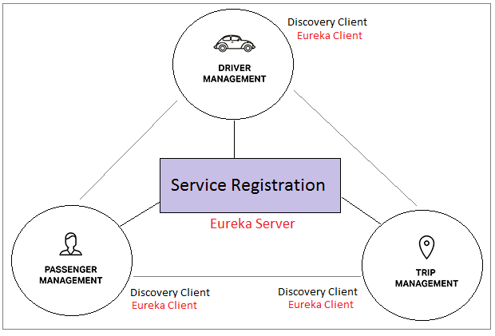

Slide 39
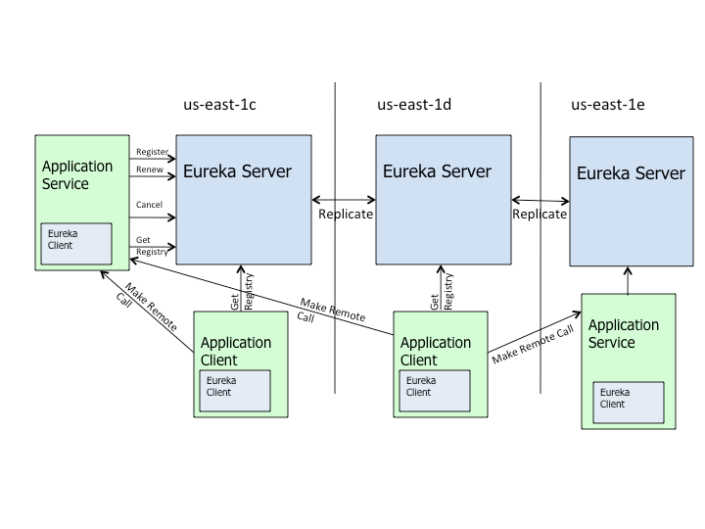
Eureka Server & Eureka Client
Notes:
https://cloud.spring.io/spring-cloud-netflix/reference/html/

Slide 40
Microservice Communication
RestTemplate
FeginClient
WebClient

Slide 41
Microservice Communication
RestTemplate (Blocking & Synchronous calls)
RestTemplate is used for making the synchronous call. When using RestTemplate, the URL parameter is constructed programmatically, and data is sent across to the other service. In more complex scenarios, we will have to get to the details of the HTTP APIs provided by RestTemplate or even to APIs at a much lower level.
RestTemplate uses the Java Servlet API, which is based on the thread-per-request model.
This means that the thread will block until the web client receives the response. The problem with the blocking code is due to each thread consuming some amount of memory and CPU cycles.
Let's consider having a lot of incoming requests, which are waiting for some slow service needed to produce the result.
Sooner or later, the requests waiting for the results will pile up. Consequently, the application will create many threads, which will exhaust the thread pool or occupy all the available memory. We can also experience performance degradation because of the frequent CPU context (thread) switching.

Slide 42
Microservice Communication
FeignClient
is a Spring Cloud Netflix library for providing a higher level of abstraction over REST-based service calls. Spring Cloud Feign works on a declarative principle. When using Feign, we write declarative REST service interfaces at the client, and use those interfaces to program the client. The developer need not worry about the implementation …
Feginclient we do not need to write any implementation to call the other services. So there is no need to write any unit test as there is no code to test in the first place.
<dependency>
<groupId>org.springframework.cloud</groupId>
<artifactId>spring-cloud-starter-openfeign</artifactId>
</dependency>

Slide 43
Microservice Communication
WebClient uses an asynchronous, non-blocking solution provided by the Spring Reactive framework.
While RestTemplate uses the caller thread for each event (HTTP call), WebClient will create something like a “task” for each event. Behind the scenes, the Reactive framework will queue those “tasks” and execute them only when the appropriate response is available.
The Reactive framework uses an event-driven architecture. It provides means to compose asynchronous logic through the Reactive Streams API. As a result, the reactive approach can process more logic while using fewer threads and system resources, compared to the synchronous/blocking method.
WebClient is part of the Spring WebFlux library. Therefore, we can additionally write client code using a functional, fluent API with reactive types (Mono and Flux) as a declarative composition.
Dependency : Spring Reactive Web
<dependency>
<groupId>org.springframework.boot</groupId>
<artifactId>spring-boot-starter-webflux</artifactId>
</dependency>

Slide 44
Zuul Proxy Server and Routing
Zuul Server is a gateway application that handles all the requests and does the dynamic routing of microservice applications.
The Zuul Server is also known as Edge Server.
It provides dynamic routing, monitoring, resiliency, security, and more

Slide 45
Zuul Proxy Server and Routing
Zuul provides a range of different types of filters that allows us to quickly and nimbly apply functionality to our edge service. The filters perform the following functions:
Authentication and Security: It provides authentication requirements for each resource.
Insights and Monitoring: It tracks meaningful data and statistics that give us an accurate view of production.
Dynamic Routing: It dynamically routes the requests to different backed clusters as needed.
Stress Testing: It increases the traffic to a cluster in order to test performance.
Load Shedding: It allocates capacity for each type of request and drops a request that goes over the limit.
Static Response Handling: It builds some responses directly at the edge instead of forwarding them to an internal cluster.
Multi-region Resiliency: It routes requests across AWS regions in order to diversify our ELB usage.

Slide 46
Zuul Components
Zuul has mainly four types of filters that enable us to intercept the traffic in different timeline of the request processing for any particular transaction. We can add any number of filters for a particular url pattern.
pre filters – are invoked before the request is routed.
post filters – are invoked after the request has been routed.
route filters – are used to route the request.
error filters – are invoked when an error occurs while handling the request.

Slide 47
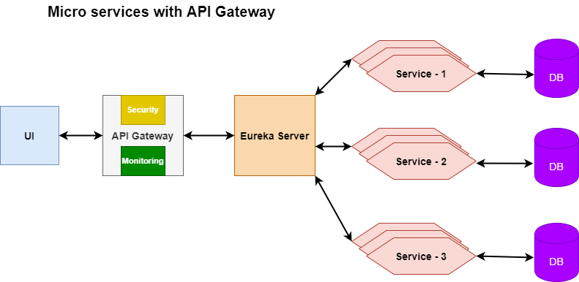
Zuul Proxy Server and Routing

Slide 48
Dependency
Eureka client
Devtools
Web
Eurekaclient
@EnbleEurekaClient or @EnableDiscoveryClient annotaions are optional in main class
Eureka Server
Devtools
EurekaServer
@EnableEurekaServer (main class mandatory)
Application.properties (mandatory statements)
Server.port=8761
eureka.client.register-with-eureka=false

Slide 49
?

